Slide 1
Welcome!
Please, have a seat.
CWRU Quants
quants@case.edu
Notes:
CHristo

Slide 2
AGENDA
Meet the Team
Overview of Quant Finance
Club Structure and Projects
Upcoming Events
Intro to Quant Firms
Notes:
Christo

Slide 3
GET TO
KNOW US!

Slide 4
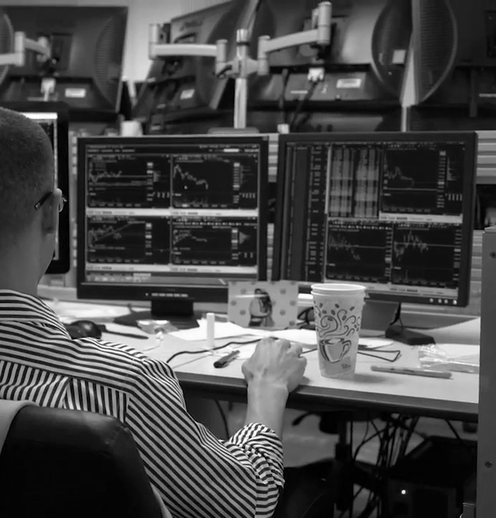
MEET THE TEAM
Notes:
Christo

Slide 5
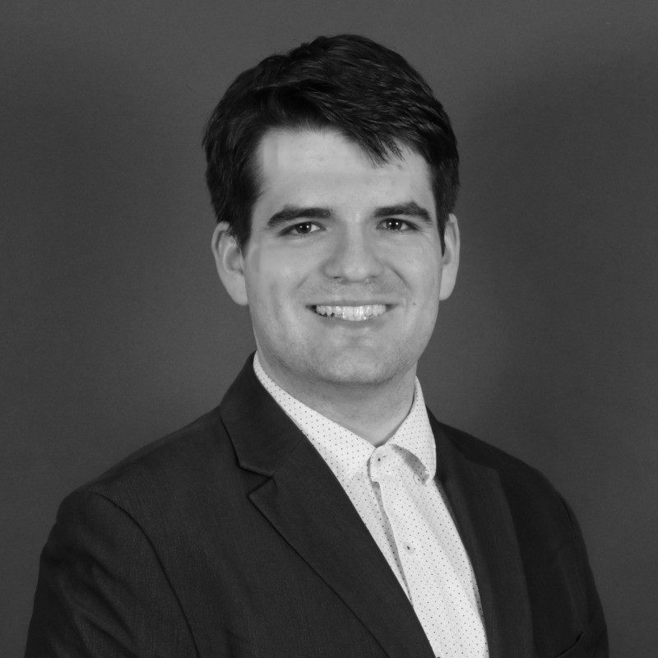


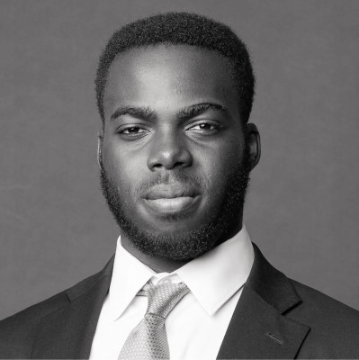

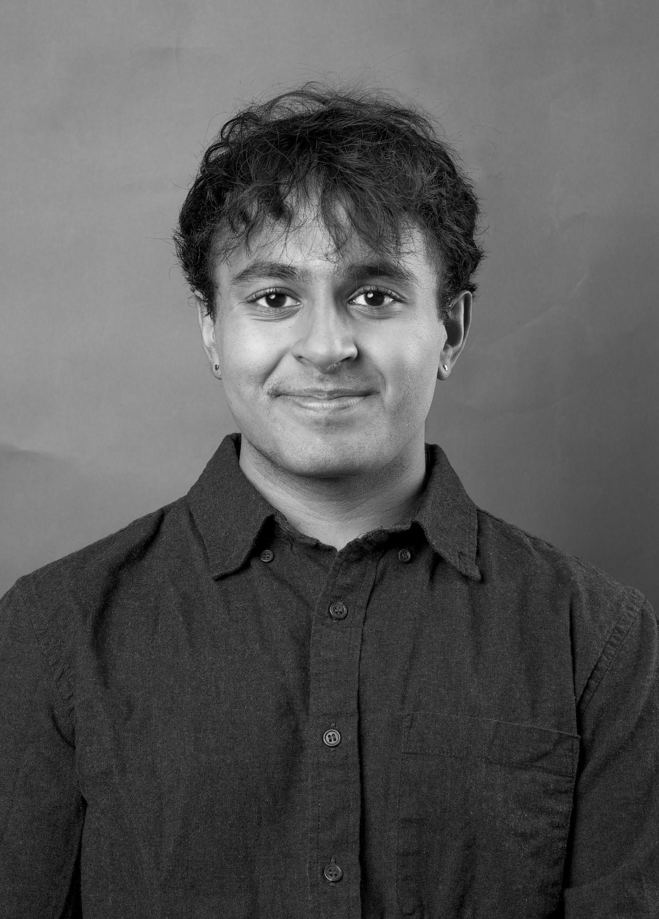
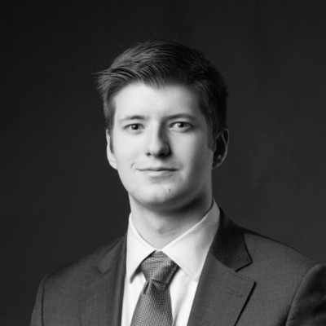
Executive Team
Ethan Fang
President and Head of Research
Computer Science Senior/M.S.
Quant Analytics @ Key
ML Research
Karel Stryczek
Vice President
Applied Mathematics Junior
Applied Physics Research Intern @ CTU Prague
Math SI
Ray Ikome
Head of Development
Computer Science and Math Junior
SWE @ Google (x2)
SWE @ Microsoft
Research @ Weatherhead
Sid Jindal
Head of Education
Math & Econ Junior/M.S.
Math Dept. Research Scholar
Econ Dept. Research Asst. (x2)
Teaching Assistant (x5)
Monish Sinha
Secretary
Data Science & Fintech Junior
Data Sci. @ PNC
Data Sci. @ Sherwin-William
AIB Board
August Matkov
Treasurer
Computer Science and Finance Senior
Wealth Management @ WEG
SWE @ Vesta (x2)
Notes:
Everyone

Slide 6
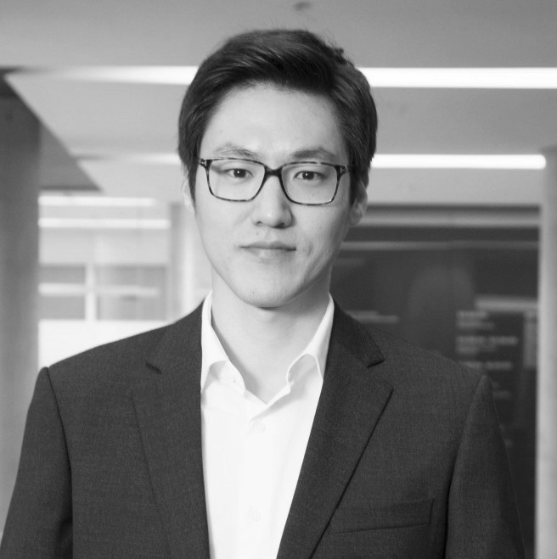
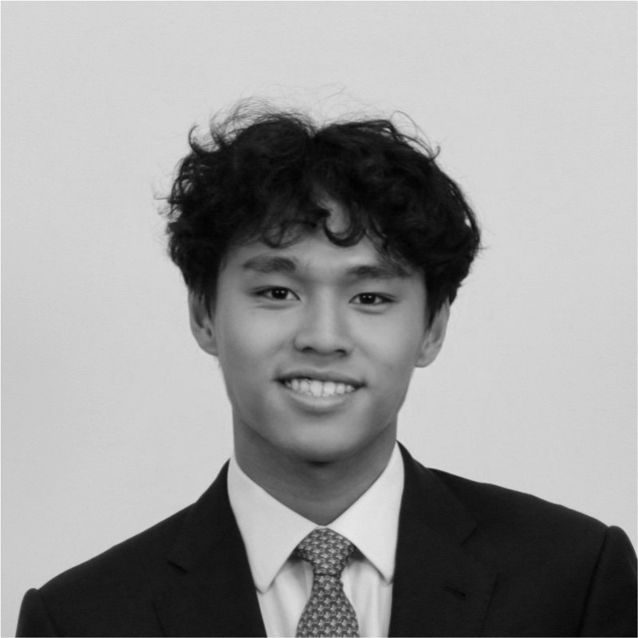

Advisory Board
Joon Woo Bae
Faculty Advisor
Associate Professor of Banking and Finance
Research Analyst @ UTAM
Christo Ekimov
Former President and Co-Head of Trading
Quantitative Econ and Statistics Senior
Financial Modeling @ CAT
Research @ Northwestern
Tom Lin
Former Co-Head of Trading
and Treasurer
Economics and Math Junior
IB @ Morgan Stanley
IB @ Roosevelt & Cross
SWE @ Trillium Trading
Tori Sydeski
Head of Public Relations
Mechanical Engineering Junior
Engineering Lead @ Surreality Lab
Research @ UPitt
Teaching Assistant
Notes:
Everyone

Slide 7
OVERVIEW OF QUANT FINANCE
Notes:
Ray Ikome

Slide 8
What is Quant Finance?
Math/Stats
Computing
Divisions
QF is concerned with the application of mathematical methods, data analysis, and computation to trading and investing in financial markets
Places a heavy emphasis on tech, from nanosecond optimized trading infrastructure to petabyte-scale big data pipelines
Sales and Trading, Financial Strategies & Research, Portfolio Management, Risk Management, Data Science roles
Notes:
Ray Ikome
The finance industry in the last 2-3 decades has undergone a transformation. Deregulation and technological advancements resulted in competing markets and reduced execution costs

Slide 9
Roles within Quant Finance
Quant Research (QR)
Quant Trading (QT)
Quant Dev (QD)
Work on designing new pricing models and strategies
Most mathematically rigorous work
Execute new trades using programs and monitoring existing trades
Mental math and market making skills
Developing, implementing, and maintaining programs used for new strategies
HPC and system-level programming knowledge
Notes:
Ethan

Slide 10

CLUB STRUCTURE AND
PROJECTS
Notes:
Sid

Slide 11
Club Structure
GB Member
Vertical Cohort Member
Education-focused to develop the skills/knowledge one needs to make an impact in groups
Project reviews, industry guest speakers, case studies, interview prep
Projects will explore an area of the markets and an area of quant finance
Examples of markets include equities, derivatives, fixed income, and even sports/election betting
Projects will focus on development/research
This is the club’s first second year—things may change!
Notes:
Sid
Projects TBD – still figuring out what opportunities present themselves

Slide 12
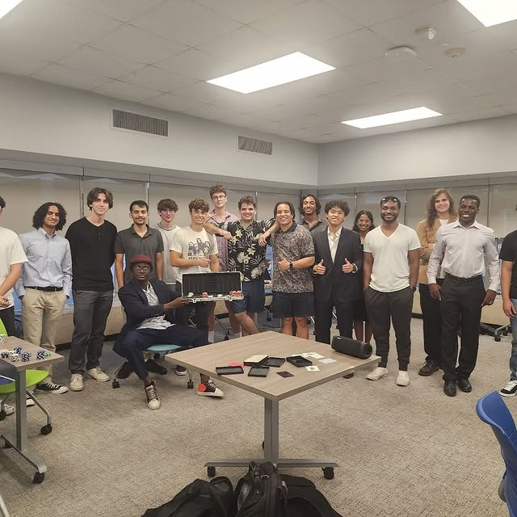
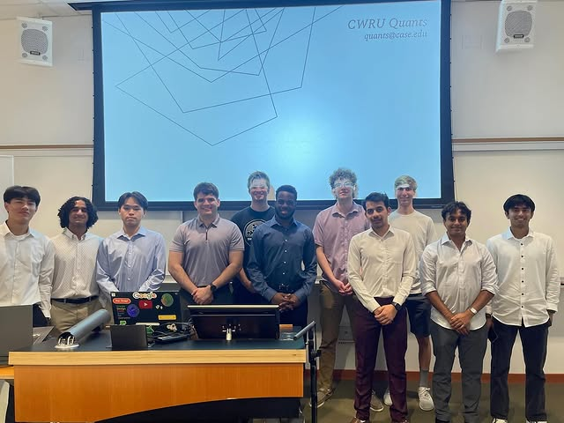
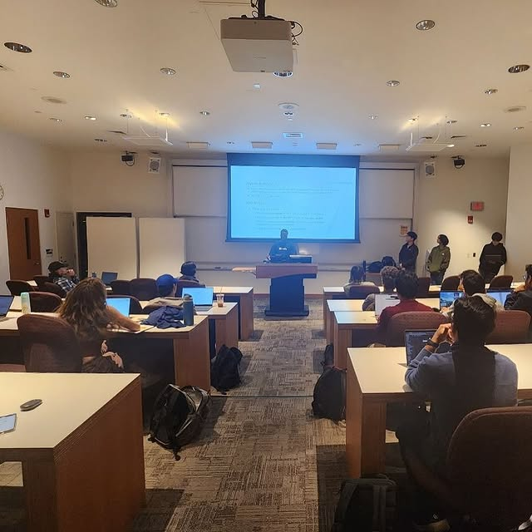
First year recap
Notes:
Christo / Ethan

Slide 13
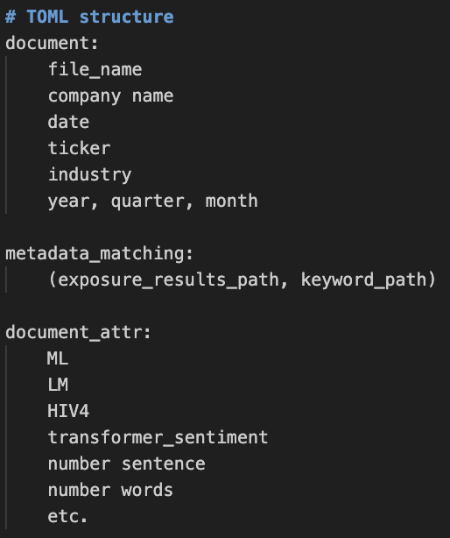
Research Vertical
Data Mining for Sentiment Features + Dataset Creation
Applications into trading public companies, equities, and more…
Models
Structured / Unstructured data
ex: earnings calls, web scraped tiktok data, twitter feeds, news feeds
RNNs, LSTMs, Transformers, Batch Transformers, XGBoost..
Notes:
Sid
Projects TBD – still figuring out what opportunities present themselves

Slide 14
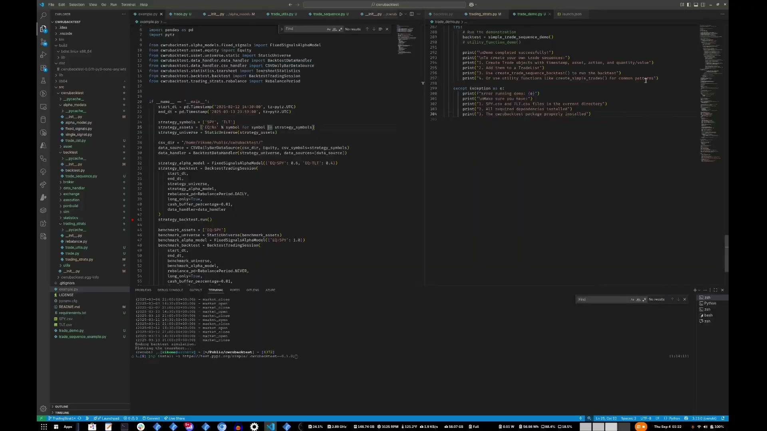
Development Vertical
Notes:
Christo / Ethan

Slide 15
Education Vertical
Cohort members who are not part of research or development, or do not have sufficient experience/time for those verticals, can participate in education.
Work together to study fundamental topics in quantitative finance, machine learning, or whatever you find interesting
Present learned topics to the club
Same commitment, same learn by doing experience, but different application
Highly recommended to underclassmen!
Topics we’re looking to cover:
Introduction to machine learning
Introduction to risk and derivatives
Notes:
Christo / Ethan

Slide 16
UPCOMING EVENTS
Notes:
Christo

Slide 17
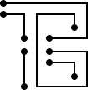



Events
Social
Food
Networking
Poker Nights
Merch
Career
Workshops
Project Groups
Guest Speakers
Travel
Trading competitions
Conferences
Notes:
Tom
The finance industry in the last 2-3 decades has undergone a transformation. Deregulation and technological advancements resulted in competing markets and reduced execution costs

Slide 18
Upcoming Events
Sept 12: Poker Night | Sept 18: Quants x CMU MSCF | Sept 19: Resume Workshop
We will be having this from 5-7PM next Friday, September 12th, in the Student Activities Center in Tink. Don’t know how to play poker? That’s okay! We will have a separate area to introduce new players into the game. | September 18, 6-7PM, PBL203 Carnegie Mellon’s MS in Computational Finance program is a target master’s program, often seen as a pipeline directly into quant. Bob Simon, executive director, will be visiting Case to speak with CWRU Quants and the greater quant finance community. | Learn from our exec and advisors, who have seen success in top firms across industries. Prepare your resume to apply for research, internships, and fellowships!
Notes:
Ray

Slide 19
Tell us about you!
Year?
Major? (Math, CSDS, Eng, Business, Finance, Premed realm)
What other clubs are you interested in joining?
Baja
Weatherhead Fund
CWRU Collaborative Coding Club
etc.
Notes:
Tom

Slide 20
Intro to Quantitative Finance
Firms
Notes:
Christo

Slide 21
Why do these firms exist?
does anyone know what a market is?
Notes:
Tom

Slide 22
Why do these firms exist?
market - system, place, or arrangement where buyers and sellers interact to exchange goods, services, or assets
How are prices in the market determined?
Is there such thing as a “true” value of something?
Notes:
Tom

Slide 23
Why do these firms exist?
efficient market hypothesis - hypothesis that share prices reflect all information known and consistent alpha generation is impossible
Or basically…that shares are always at fair value, and there is no real value to be gained from trading in the market
The existence of an efficient market…implies the existence of an inefficient market – where asset prices do not accurately reflect their true value.
Inefficient markets can exist due to information asymmetry, low liquidity, high transaction costs or delays, human emotions, amongst other reasons you can argue.
So therefore… these firms take advantage of the market! In addition to market inefficiencies, there are also fees that you have to pay to market makers for liquidity, amongst other methods to capture $ in the market.
Notes:
Tom

Slide 24
What types of firms are there?
Proprietary Trading (Prop Shops)
Trade with their own capital
Profits and losses stay within the firm
Traders typically get a higher cut of their profits
Strategies generally focus on HFT, market making, arbitrage, short horizon strategies
Examples: Jane Street, Citadel Securities, Jump, HRT, Optiver
Hedge Funds
Manage outside capital (institutions, pensions, family offices, UHNWIs)
Charge fees (2/20 model)
More risk controlled because trading other people’s money
Strategies are wider range – long/short equity, global macro, events, quant trading, discretionary vs. systematic
Examples: Citadel (quant pods), Millennium, Point72, DE Shaw, Two Sig
Banks
Trade for clients and manage their own balance sheet
Restricted from pure prop trading
Price derivatives and structured products
Risk management and regulatory capital models
Examples: Goldman Sachs, JP Morgan
Notes:
Ray

Slide 25
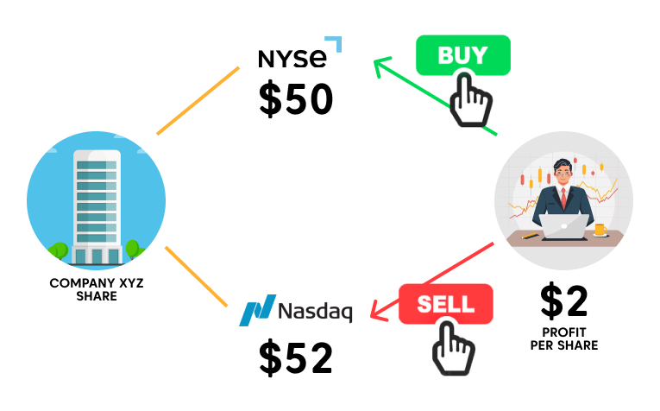
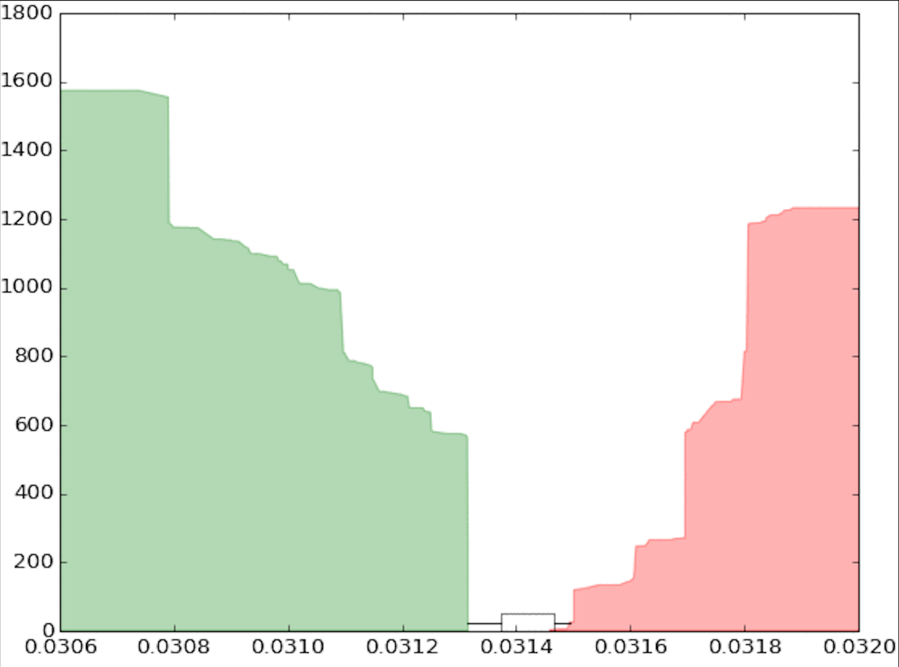
How do these firms make money?
Market makers profit by buying low and selling high through the bid-ask spread. They provide continuous liquidity and aim to maintain a balanced inventory to avoid excessive directional exposure.
What is the bid ask spread?
Notes:
Tom

Slide 26
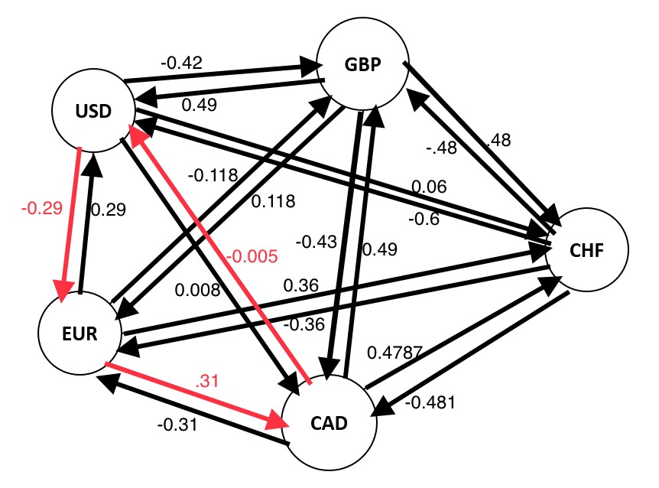
How do these firms make money?
Arbitrage strategies seek to exploit pricing inefficiencies between related markets or instruments.
Notes:
Tom

Slide 27
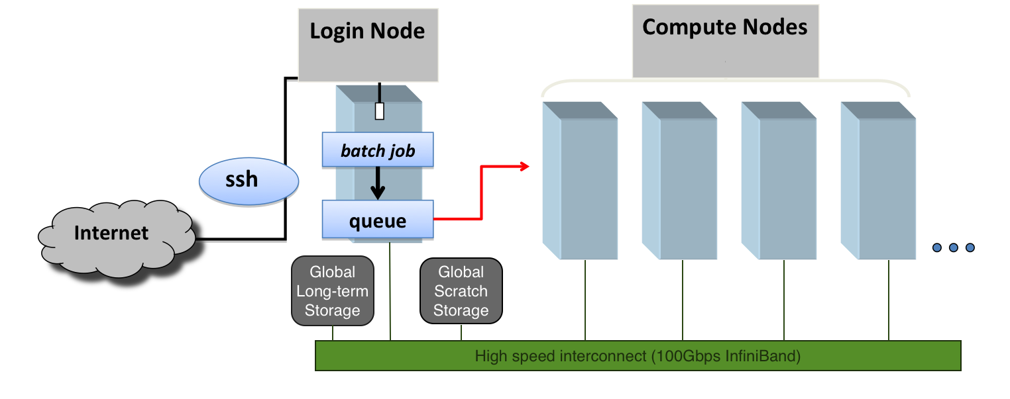
How do these firms make money?
High Frequency Trading (HFT) leverages speed, algorithmic execution, and colocation near exchanges to capture tiny pricing inefficiencies across very short time horizons. This might include latency arbitrage, market making, or other anticipations
Notes:
Tom

Slide 28
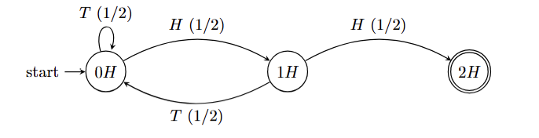
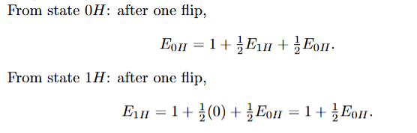
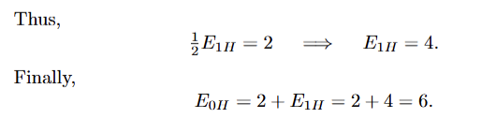
So what about that brainteaser?
Given a fair coin, what’s the expected number of flips until we get 2 consecutive heads?

Slide 29



Social Links
@cwruquants
@cwruquants
@cwruquants
Notes:
CHristo

Slide 30
QUESTIONS
AND ANSWERS
Contact us!
Email: quants@case.edu
Instagram: @cwruquants
Notes:
Sid

